Slide 1
POLICE MANAGEMENT SYSTEM

Slide 2
TABLE STRUCTURE
TABLE NAME: ADMIN
FIELD | DATA TYPE | SIZE | CONSTRAINT
Adminid | Int | 10 | Primary key
Username | Varchar | 20 | Not null
password | Varchar | 20 | Not null
TABLE NAME: POLICE STATION
FIELD | DATA TYPE | SIZE | CONSTRAINT
Station id | Int | 10 | Primary key
Station name | Varchar | 20 | Not null
Address 1 | Varchar | 30 | Not null
Address 2 | Varchar | 30 | Not null
City | Varchar | 15 | Not null
State | Varchar | 15 | Not null
Pincode | Int | 6 | Not null
Landline number | int | 10 | Not null

Slide 3
TABLE NAME: CITIZEN
FIELD | DATA TYPE | SIZE | CONSTRAINT
citizen id | Int | 10 | Primary key
Firstname | Varchar | 20 | Not null
Lastname | Varchar | 20 | Not null
Mobile | Int | 10 | Not null
Address 1 | Varchar | 30 | Not null
Address 2 | Varchar | 30 | Not null
Areaname | Varchar | 15 | Not null
City | Varchar | 15 | Not null
State | Varchar | 16 | Not null
Pincode | Varchar | 6 | Not null

Slide 4
TABLE NAME : COMPLAINT
FIELD | DATA TYPE | SIZE | CONSTRAINT
Complaint id | Int | 10 | Primary key
Citizen id | Int | 10 | Foreign key
Station id | Int | 10 | Foreign key
Complaint person | Varchar | 20 | Not null
Complaint issue | Varchar | 30 | Not null
Current address | Varchar | 30 | Not null

Slide 5
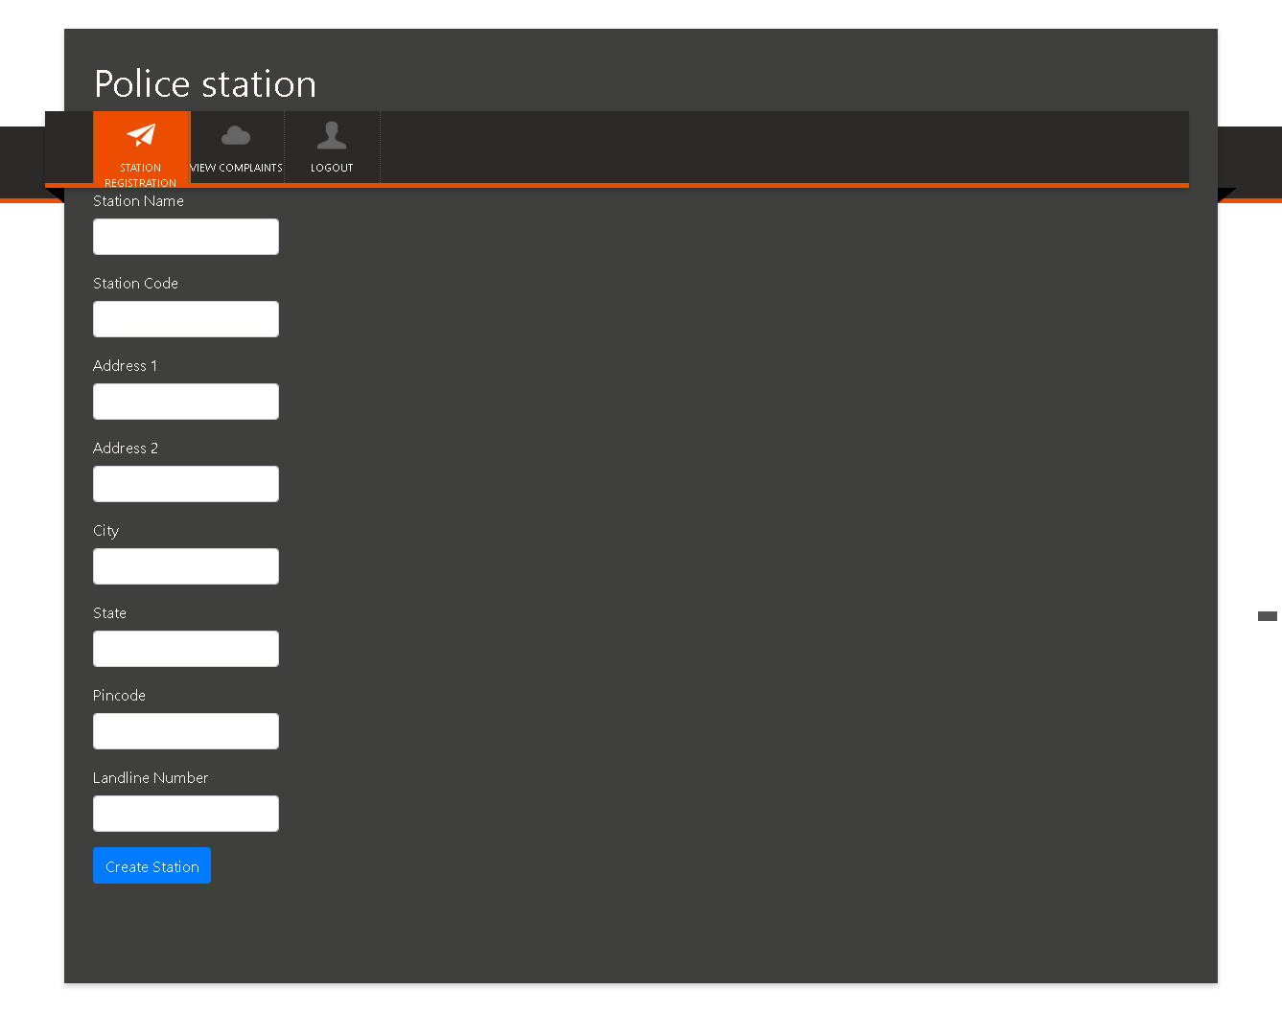

Slide 6
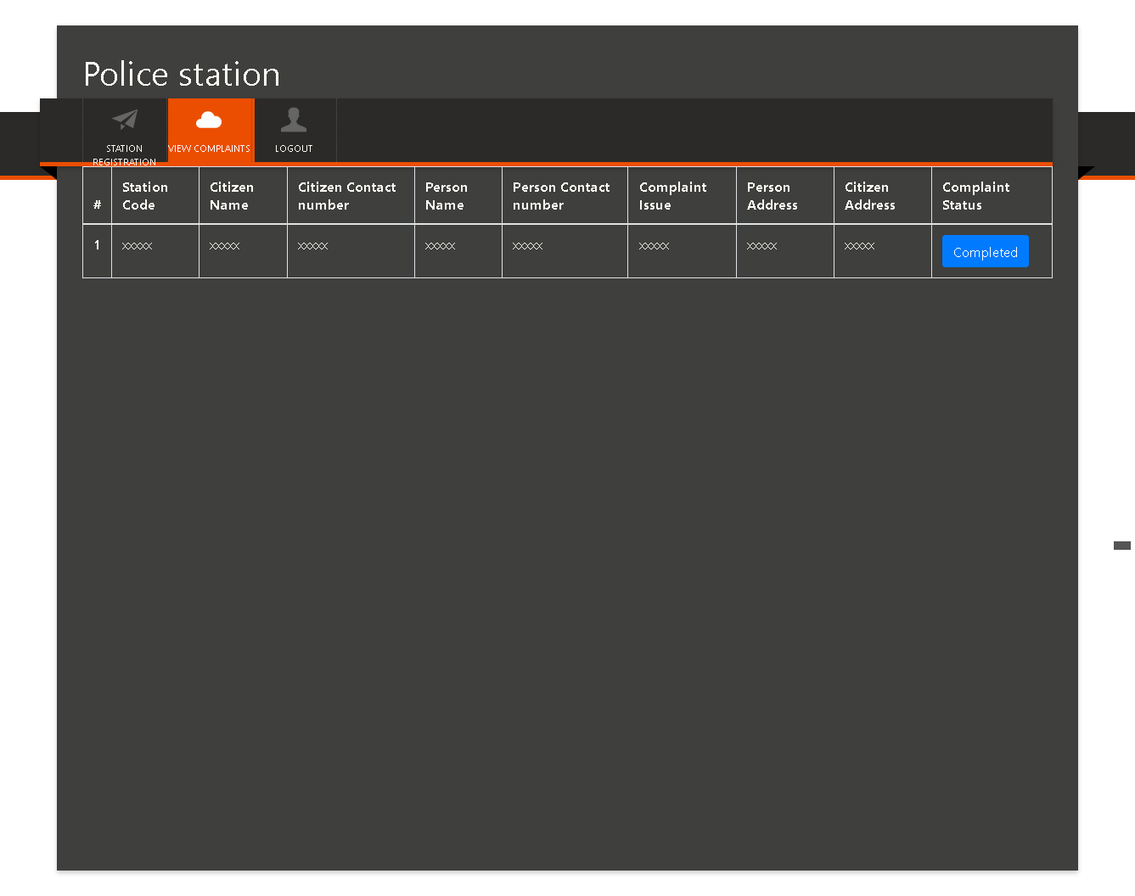

Slide 7
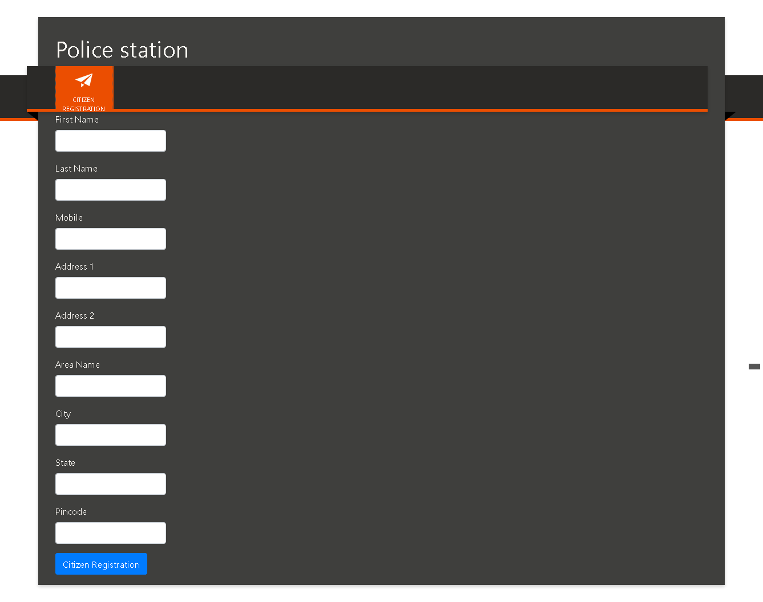

Slide 8
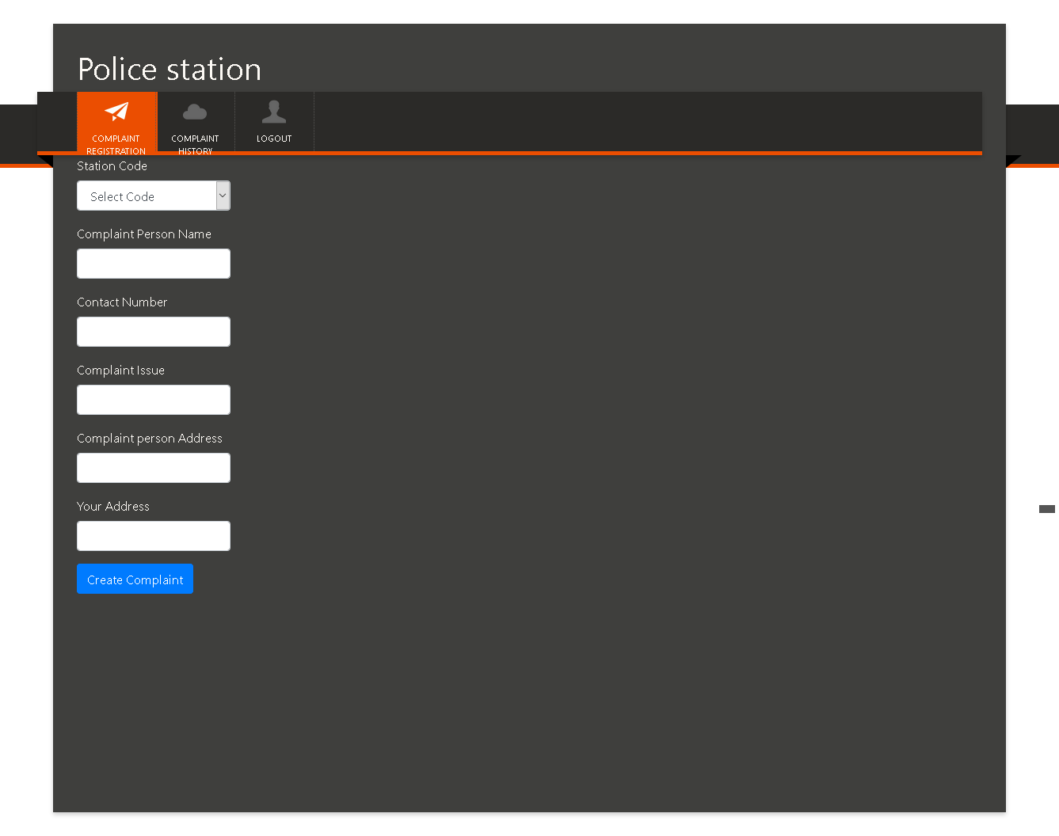

Slide 9
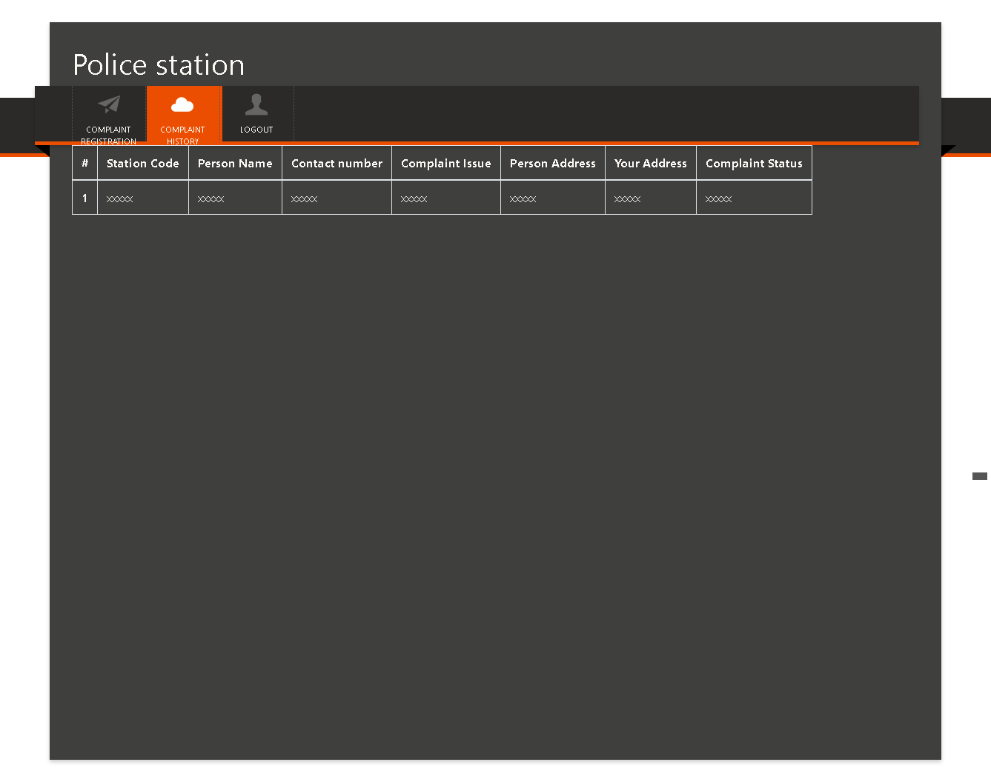

Slide 10
Thank you…..,

